Slide 1


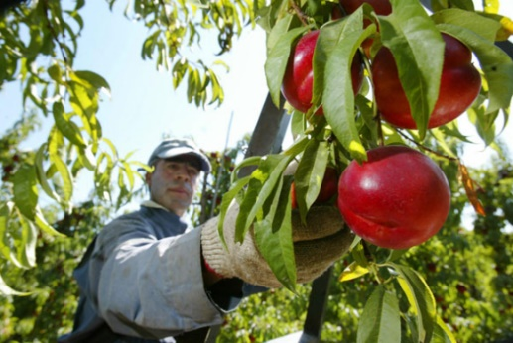

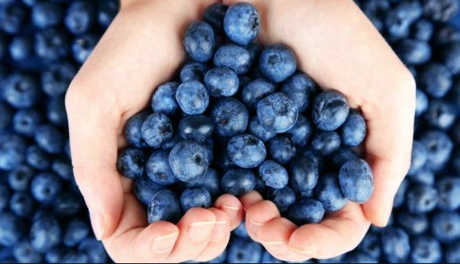

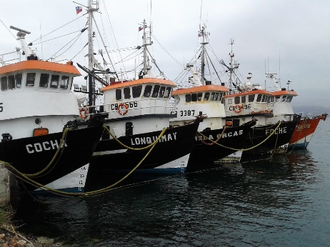
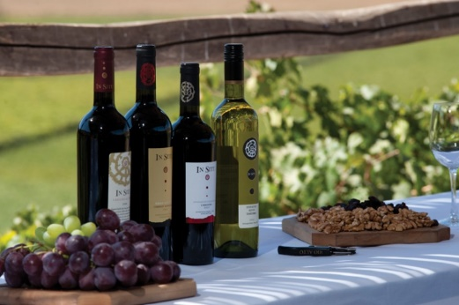
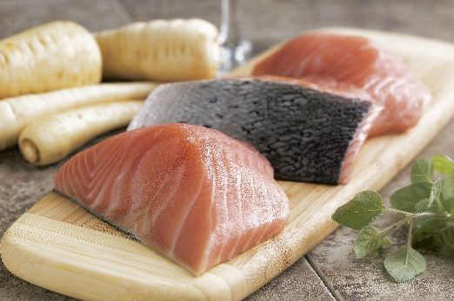
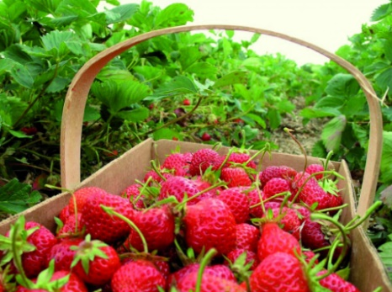
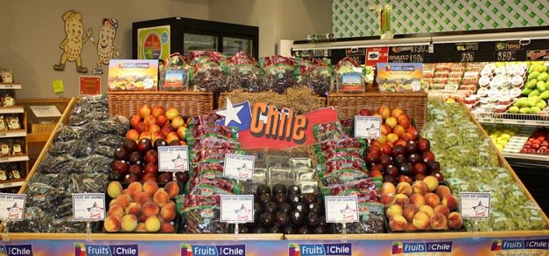

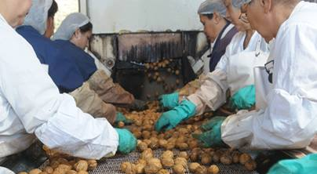
Chilean Foods
The EXPORTING INDUSTRY

Slide 2











Chilean
FOOD EXPORTING INDUSTRY
The food sector is the second largest exporter in Chile, after mining, with shipments amounting to US$ 16 billion in 2016.
It is the industry with the highest growth potential in the country. In 10 years, copper has expanded 4% in terms of volume, while the sum of all activities in the food sector is ten times higher.
It is a key sector for the future of humanity, where Chile has the possibility to play a relevant role in terms of coping with the increasing global demand for food products.
This document represents the vision of the trade associations grouped under the Food Export Council

Slide 3

A successful
EXPORT TRACK RECORD
The Chilean food manufacturing industry has positioned itself successfully in global markets, ranking as top global players in production and sales as a result of their efforts and thanks to the support of the authorities.
It is a sector that has a strong commitment toward Chile’s development, and adds high value to their final products by means of productive investments, in technology, food safety, health, logistics, cold chain, sustainability, market development, marketing management and spreading a positive image of the country.
A success that has ultimately translated into the creation of employment and ongoing training of workers.
“Chile has a world class food industry, with a strong production chain in terms of research, manufacturing, distribution, industrial processes, logistics and finally, consumer research in each market”.
Guillermo González, ChileAlimentos
The Chilean FOOD Exporting Industry

Slide 4

We export to
200 COUNTRIES
The quality of our products has allowed us to open and maintain our presence in global markets: whereas in 2003, exports reached US$ 6 billion, in 2016 this figure increased to US$ 16 billion.
Chile is ranked among the top five exporting countries among those in which the food sector is relevant to the overall economy.
2016
FOOD EXPORTS IN CHILE
16
Billion
2003
US$
6 Billion
US$
““In 2015, the fruit industry accounted for 38.7% of the Agrofrestry GDP and 1.3% of the domestic GDP. In addition, the sector makes a significant contribution to the country´s exporting effort, accounting for 8.7% of its total value in 2016”.
Ronald Bown, Asoex
The Chilean FOOD Exporting Industry

Slide 5

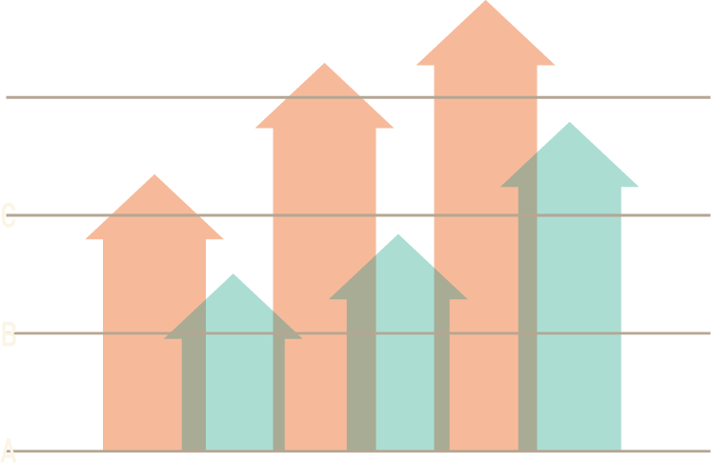
But we have a CHALLENGING ENVIRONMENT
The Chilean experience has been adopted, and at times surpassed, by competitor countries that now have increased resources to promote their exports globally.
This is why we need to promote a favorable political and legal framework and further strengthen coordination between the public and private sectors, in order to build increased leadership and improve the country’s image in the long term.
“The industry and the authorities must contribute to the country by instilling a sense of value and promoting Chile as a hidden treasure at the end of the world”.
Claudio Cilveti, Vinos de Chile
The Chilean FOOD Exporting Industry

Slide 6
The Main Non Mining EXPORTING SECTOR
In 2016, food accounted for 27% of total shipments from Chile and 54% to non mining products.
It is the most important non mining exporting sector in the country and a development driver of the domestic economy.
Basic metal industry
Other industrial products
Metal products, machinery and equipment
Forestry and wooden furniture
Cellulose, paper and others
Chemical products
Foods
Mining
1%
2%
4%
4%
5%
7%
27%
51%
SHARE OF VARIOUS SECTORS IN TOTAL EXPORT VALUES CHILE, 2016
Source: Developed on the basis of statistics from Central Bank of Chile.
“In 2018, we shall cross the threshold of 100.000 tons of walnut production, which shows the credibility we have achieved in international markets, and the efforts in infrastructure and processing capacity of exporting companies, including many small and medium enterprises”.
Karl Samsing, Chilean Walnut Commission
The Chilean FOOD Exporting Industry

Slide 7










Food, a GREAT
EMBASSADOR for Chile
82
M.
people
11
Eat fresh fruit from Chile.
Chile is ranked in 24th place among the major global food exporters.
We are present in the diets of large part of the world population. We are great ambassadors of Chile´s country image.
M.
people
10
9
Eat one serving of Chilean pork
M.
M.
people
people
Eat a portion of Chilean salmon.
Eat a handfull of Chilean walnuts.
EVERY day
IN THE WORLD…
7,7
M.
6
people
M.
people
Eat a handfull of Chlean dehydrated prunes.
Drink a glass of Chilean Milk.
5
M.
“In 10 years, exports of olive oil have increased in 2.900%. This figure may increase even more with the support of dissemination policies to strengthen our presence in important markets such as the USA,, Brazil and Asia”.
Gabriela Moglia, Chileoliva
3,7
M.
people
people
Drink a glass of Chilean wine.
Eat a portion of Chilean chicken meat.
Fuente Elaboración propia, Aduanas de Chile.
Chilean FOOD Exporting Industry

Slide 8
A key sector to develop
COUNTRY BRAND
Our products are available in countries that respresent 95% of the world population.
Chile exports to countries in every continent and is one of the main suppliers of food in Brazil, the United States and Japan.
This export vocation of the food sector helps to develop our country brand.
The USA is a fan of our products, after Canada and Mexico, their direct neighbors, and a giant such as China, Chile together with France, is the country that sells the most food to this country.
30
25
20
15
10
5
0
México
Canadá
China
Francia
Chile
Italia
Indonesia
Vietnam
Tailandia
India
Brasil
Australia
Reino Unido
Nueva Zelandia
Perú
Guatemala
Países Bajos
España
Ecuador
Colombia
Costa Rica
20%
18%
16%
14%
12%
10%
8%
6%
4%
2%
0%
18,1%
17,1%
Share and Value of Food Exports to the USA from main Food Supplying Countries – 2016
Miles de Millones de dólares
5,0%
3,9%
3,9%
3,5%
2,7%
2,7%
2,7%
2,6%
2,5%
2,4%
2,0%
1,9%
1,7%
1,6%
1,6%
1,6%
1,4%
1,3%
1,3%
“Chile is a market of 18 million consumers; only Shanghai, in China, has the same population. Increased exports will allow us to produce more and create new job opennings, especially in rural areas where people used to migrate to the city to find employment opportunities”.
Juan Carlos Domínguez, Expocarnes
The Chilean FOOD Exporting Industry

Slide 9
We are the MAIN GLOBAL SUPPLIER in various food categories
CHILE IS CONQUERING THE WORLD WITH ITS FLAVORS
12 Chilean food products hold 1st place at the global level in terms of their export values, and 27 hold the first three places.
1
Grapes
Frozen salmon filets
Blueberries
Cherries
Stone fruits
Dehydrated Prunes
Frozen trout filets
Cooled fresh southern hake
Canned Jack Mackerel
Frozen cooked mussels
Dehydrated apples
Frozen sea urchins
ST. Place
Chilean Food in World Rankings
"Chile is the main exporter of table grape in the world, and in 2017 we have also established the country as the main supplier of dry fruit to China".
Ronald Bown, Asoex
The Chilean FOOD Exporting Industry

Slide 10
CHILE, TOP TEN in rankings of main food exporting countries
In 90 food categories, Chile is among the first 10 global suppliers in terms of export volumes.
2°
Frozen Fruit
3°
Dehydrated Fruit
4°
Pork Meat
Wine and Musts
Frozen Fish
5°
Dried Fruit
“It is with great effort that we have conquered a place in international markets, but we require further support to promote and disseminate our products, as we have observed in the case of our main competitors in various promotion activities".
Gabriela Moglia, Chileoliva
8°
Olive Oil
Fresh Fish
The Chilean FOOD Exporting Industry

Slide 11

An essential industry to further the REGIONAL DEVELOPMENT
If we intend to descentralize, Let’s think about developing the food sector!
The industry is a driver of descentralization, providing employment opportunities to vulnerable and remote groups.
SHARE (%) IN TOTAL
EXPORTS
Los Lagos 97
Aysén 78
Maule 72
O'Higgins 55
Magallanes 54
La Araucanía 51
Valparaíso 41
Arica y Parinacota 31
Coquimbo 20
“Production of white meat is a pilar of local economic activities and one of the main sources of job creation in rural sectors of the central part of Chile. Generating a total of 28 thousand direct Jobs and 40 thousand indirect jobs”.
Juan Carlos Domínguez, Expocarnes
The Chilean FOOD Exporting Industry

Slide 12
JOBS, fundamental contribution in quantity and quality
THE FOOD INDUSTRY CREATES
SHARE OF FOOD SECTOR IN NUMBER OF DEPENDENT WORKERS 2015 (*)
1 of every 7
Arica y Parinacota
Tarapacá
Antofagasta
Atacama
Coquimbo
Valparaíso
Metropolitana
O´Higgins
Maule
Bío-Bío
La Araucanía
Los Ríos
Los Lagos
Aysén
Magallanes
60%
50%
40%
30%
20%
10%
0%
*If independent workers are added to the number of dependent workers (data from CASEN survey), the number of people linked to the sector increases significantly.
JOBS in Chile
1,4 MILLION CHILEANS have employment thanks to the sector.
In ten years, the salary and income of people involved in the food industry has doubled, increasing from 60 million UF in 2005, to 120 million UF in 2015.
“The salmon cluster is by far the most relevant in the southern and austral regions of Chile. Regions IX and XII together generate 30 thousand direct jobs and 40 thousand indirect jobs. It is justifiably, the ‘Chilean copper that we possess in the ocean”.
Felipe Sandoval, SalmonChile
The Chilean FOOD Exporting Industry

Slide 13
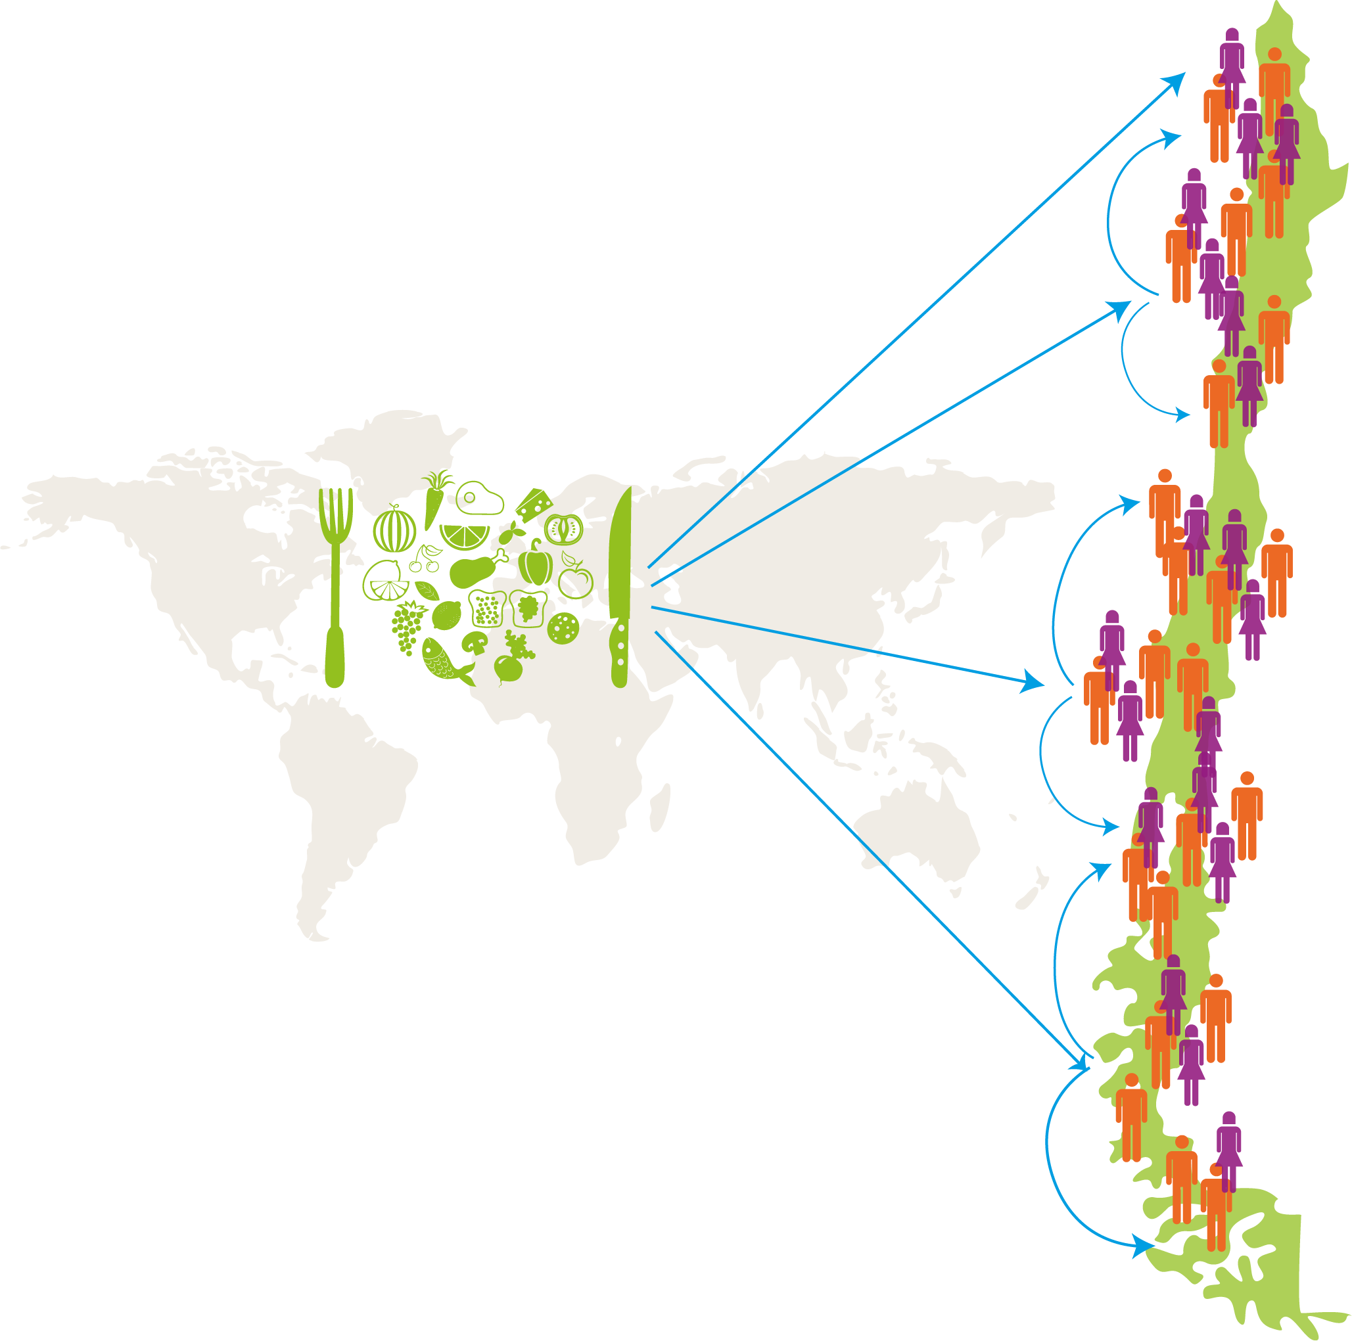
WE GENERATE important productive chains
The sector favors productive chains that benefit small and medium enterprises, and create jobs, largely in vulnerable sectors.
Each time a Chilean food product is consumed abroad, the country’s regions are benefitted with DIRECT AND INDIRECT EMPLOYMENT.
“Chilean milk products are manufactured with milk from close to 5.000 dairies located in southern regions, developing the Chilean countryside and providing direct and indirect employment to tens of thousands of Chileans”.
Guillermo Iturrieta, Exporlac
The Chilean FOOD Exporting Industry

Slide 14


We are committed with SUSTAINABLE development
Our food exporting industry is adopting the most strict environmental and social responsibility standards.
The world demands healthy high quality food with higher safety assurance and sustainability levels. Chile is satisfying these requirements.
“Fishing activities in Chile are conducted in a responsible manner, thereby respecting conservation measures and working closely with fisheries authorities, and committing to ensure the conservation of the environment by undertaking research of eventual impacts and to assess the status of fisheries resources”.
Héctor Bacigalupo, Sonapesca
The Chilean FOOD Exporting Industry

Slide 15

Chilean food products are in Line with GLOBAL NEEDS
We offer what the world will never cease needing… food.
The global food market increased to close to 6% annually in the last ten years. According to FAO, this phenomenon is due to population growth and higher incomes.
But consumers have also become increasingly more demanding. As a result, Chile has come up with specific solutions by diversifying and increasing added value to its products, applying environmental standards and prime level social responsibility.
6% annually
Across the last ten years.
Global Food Market
“Dehydrated prunes have unique features. Their consumption prevents bone fragility (osteoporosis), and further regenerates bone mass, in addition to various other beneficial effects on health, such as its high antioxidant content”.
Pedro Pablo Díaz, Chile Prunes
The Chilean FOOD Exporting Industry

Slide 16

We need to boost
PROMOTION efforts
The Chile country Brand ranks 46 among 75 countries in the Country Brand Index (2015), far below our main competitor countries.
In the last 10 years we lost competitive advantages that would allow us to exceed other countries. To compensate for this loss, we need to continue our efforts to boost our position, on the basis of a solid promotion polity and address various regulations that increase production costs and impact our level of competitiveness.
“We need to strengthen our country brand, by taking our products to consumers’ tables around the world”.
Guillermo González, Chilealimentos
The Chilean FOOD Exporting Industry

Slide 17

14 Proposals to MOVE FORWARD
4
1
Create a single agency with responsibility over resource management, country image decision making and public trade promotion, but with private sector involvement.
Prioritize CORFO resources for innovation of the overall food industry.
The creation of a fund to implement new technologies related to food industry sustainability is proposed.
Maintain the certainty of ownership, such as water rights.
Increase resources for investment in storage and distribution of water resources.
Develop a long term foods export policy to prioritize resource allocation and promotion actions.
Ensure the work of public entities present in the domestic logistic chain, securing their operability.
5
2
6
3
7
The Chilean FOOD Exporting Industry

Slide 18
14 Proposals to MOVE FORWARD
8
Develop a territorial arrangement and coastal area use policy.
Grant government agency status to the Chilean Food Safety and Quality Agency, ACHIPIA.
Ensure early involvement in regulation development.
Modernization of surveillance and certification bodies.
12
Ensure receiving timely and complete information related to foreign trade and industry related operations. Agree on the type of statistical information about the food industry.
Agree on a National Plan for Infrastructure Development, that will benefit foreign trade growth.
Establish a National Trade Facilitation Council, in accordance with WTO committments.
9
13
10
11
14
The Chilean FOOD Exporting Industry

Slide 19
A PROMISING future
We have the potential to duplicate our exports from here to 2025, reaching
US$ 32 billion.
year 2016
year 2025
US$ 16
US$ 32
BILLION
BILLION
To this end, we must develop a long term plan to maintain an average annual growth of 8% that food shipments have recorded in recent years.
The Chilean FOOD Exporting Industry

Slide 20
